Slide 1
exploratory data analysis Sample Survey Data from June 2019
Adrian Lindsey

Slide 2
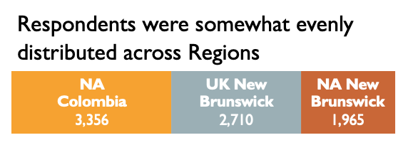
overview
A majority of respondents in both channels had positive feedback – this is likely influenced, in part, by selection bias
The survey sample data captures June 2019 with clear weekend patterns but with no other apparent weekly trends throughout cross-sections
and were mostly Retail customers
and a large majority of customer issues were resolved on the first call (RFC)

Slide 3
Key Insights

Slide 4
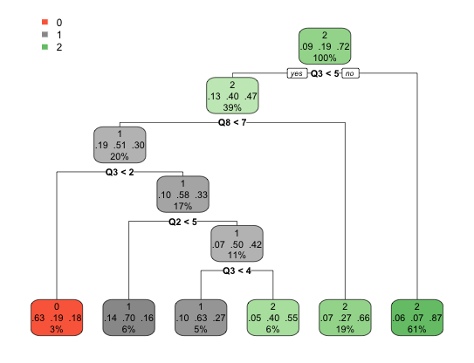
A customer will be ~33% more likely to Recommend SharkNinja (IV) even if they Rate the Product low IF they rate CES highly enough (Q8).
Product Rating (Q3) is more impactful than Service Rating (Q2) to the extent that a ”generally positive” Product Rating will result in a Propensity to Recommend.
Assumptions
Excluded respondents who don’t own a product and respondents who didn’t answer every survey question.
Tree was build using rpart library in R with 99% confidence.
0- Won’t Recommend (NPS: 0 – 4)
1- Might Recommend (NPS: 4 – 8) 2- Will Recommend (NPS: 9 – 10)
Product Rating < 5
AND CES = 7
Product Rating ≥ 4

Slide 5
Potential Next steps

Slide 6
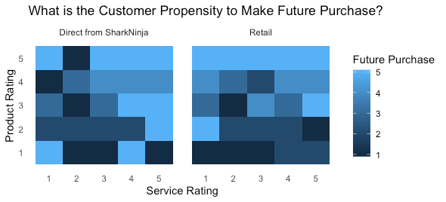
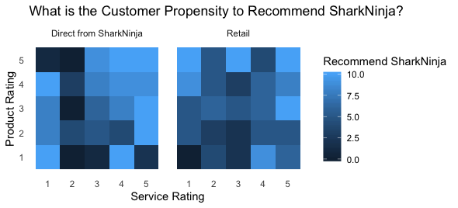
Future purchases rely more on product ratings than service Ratings
This could be explored further with more months of data using z-tests to check significance of findings and regression to identify strength of correlation.
There doesn’t appear to be a similar phenomena when measuring these ratings against Likelihood to Recommend SharkNinja.

Slide 7
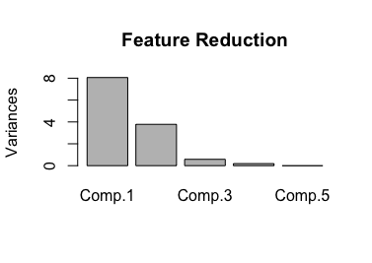
LATENT VARIABLES WERE NOT MORE STRONGLY RELATED THAN OBSERVABLE VARIABLES
SEM
Observable Variables
Latent Variables
Observable Variables
Service Rating
Recommend
SharkNinja
A next approach might be to transform some of these continuous variables and target variables in order to find hidden layers of correlation.
Also, PCA identified 2 component factors that could be investigated further.
Satisfaction
Take Action
Product Rating
26%
FCR
Make Future
Purchase
Correlations
Product Rating
Make Future
Purchase
63%
Service Rating
Recommend
SharkNinja
31%

